Slide 1
Switching Behavior of Izhikevich Model
Yoon JaeHong, Zhongxi Li
2017 November

Slide 2
Outline
Goal, background, motivation
Demo of the Izhikevich switching behavior
Valid parameters (a, b) via genetic algorithm
Setting
Goal function
algorithm
Analytical solution of (a, b)
Discussion
Extension to multiple neurons

Slide 3
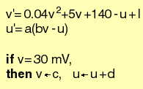
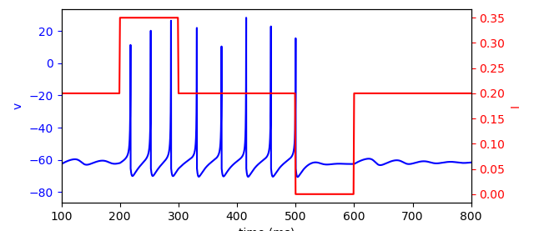
Goal
Find and explain a set of parameters such that one Izhikevich-type neuron can exhibit bi-stability.
Izhikevich model
Switching behavior
Turn on
Turn off

Slide 4
Motivation and Challenges
Motivation:
We believe biological working memory can be carried out by a single neuron with a clean mathematical interpretation.
Challenges:
The Izhikevich model is defined in a hybrid manner. The conditions make the model discontinuous.

Slide 5
Motivation and Challenges
Genetic algorithm → parameter set (a, b)
Izhikevich model
Define switching behavior
Explanation
Nonlinear dynamics analysis

Slide 6
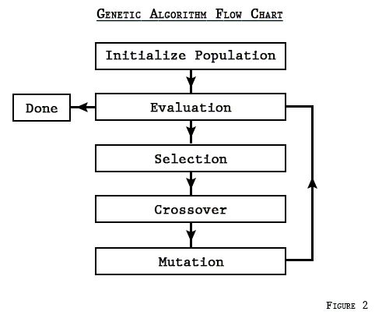
Path 1: genetic algorithm
Basic idea: select the best parameters from a pool of candidates. The best parameters then become parents of the next candidate generation.

Slide 7
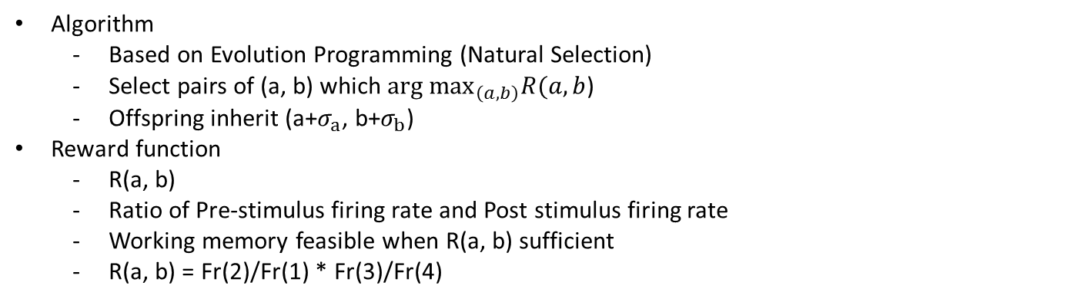
Path 1: genetic algorithm
Algorithm
Based on Evolution Programming (Natural Selection)
Select pairs of (a, b) which $arg \max_{\left(a, b\right)}R(a, b$)
Offspring inherit (a+$σ_{a}$, b+$σ_{b}$)
Reward function
R(a, b)
Ratio of Pre-stimulus firing rate and Post stimulus firing rate
Working memory feasible when R(a, b) sufficient
R(a, b) = Fr(2)/Fr(1) * Fr(3)/Fr(4)
2
1
3
4
5

Slide 8
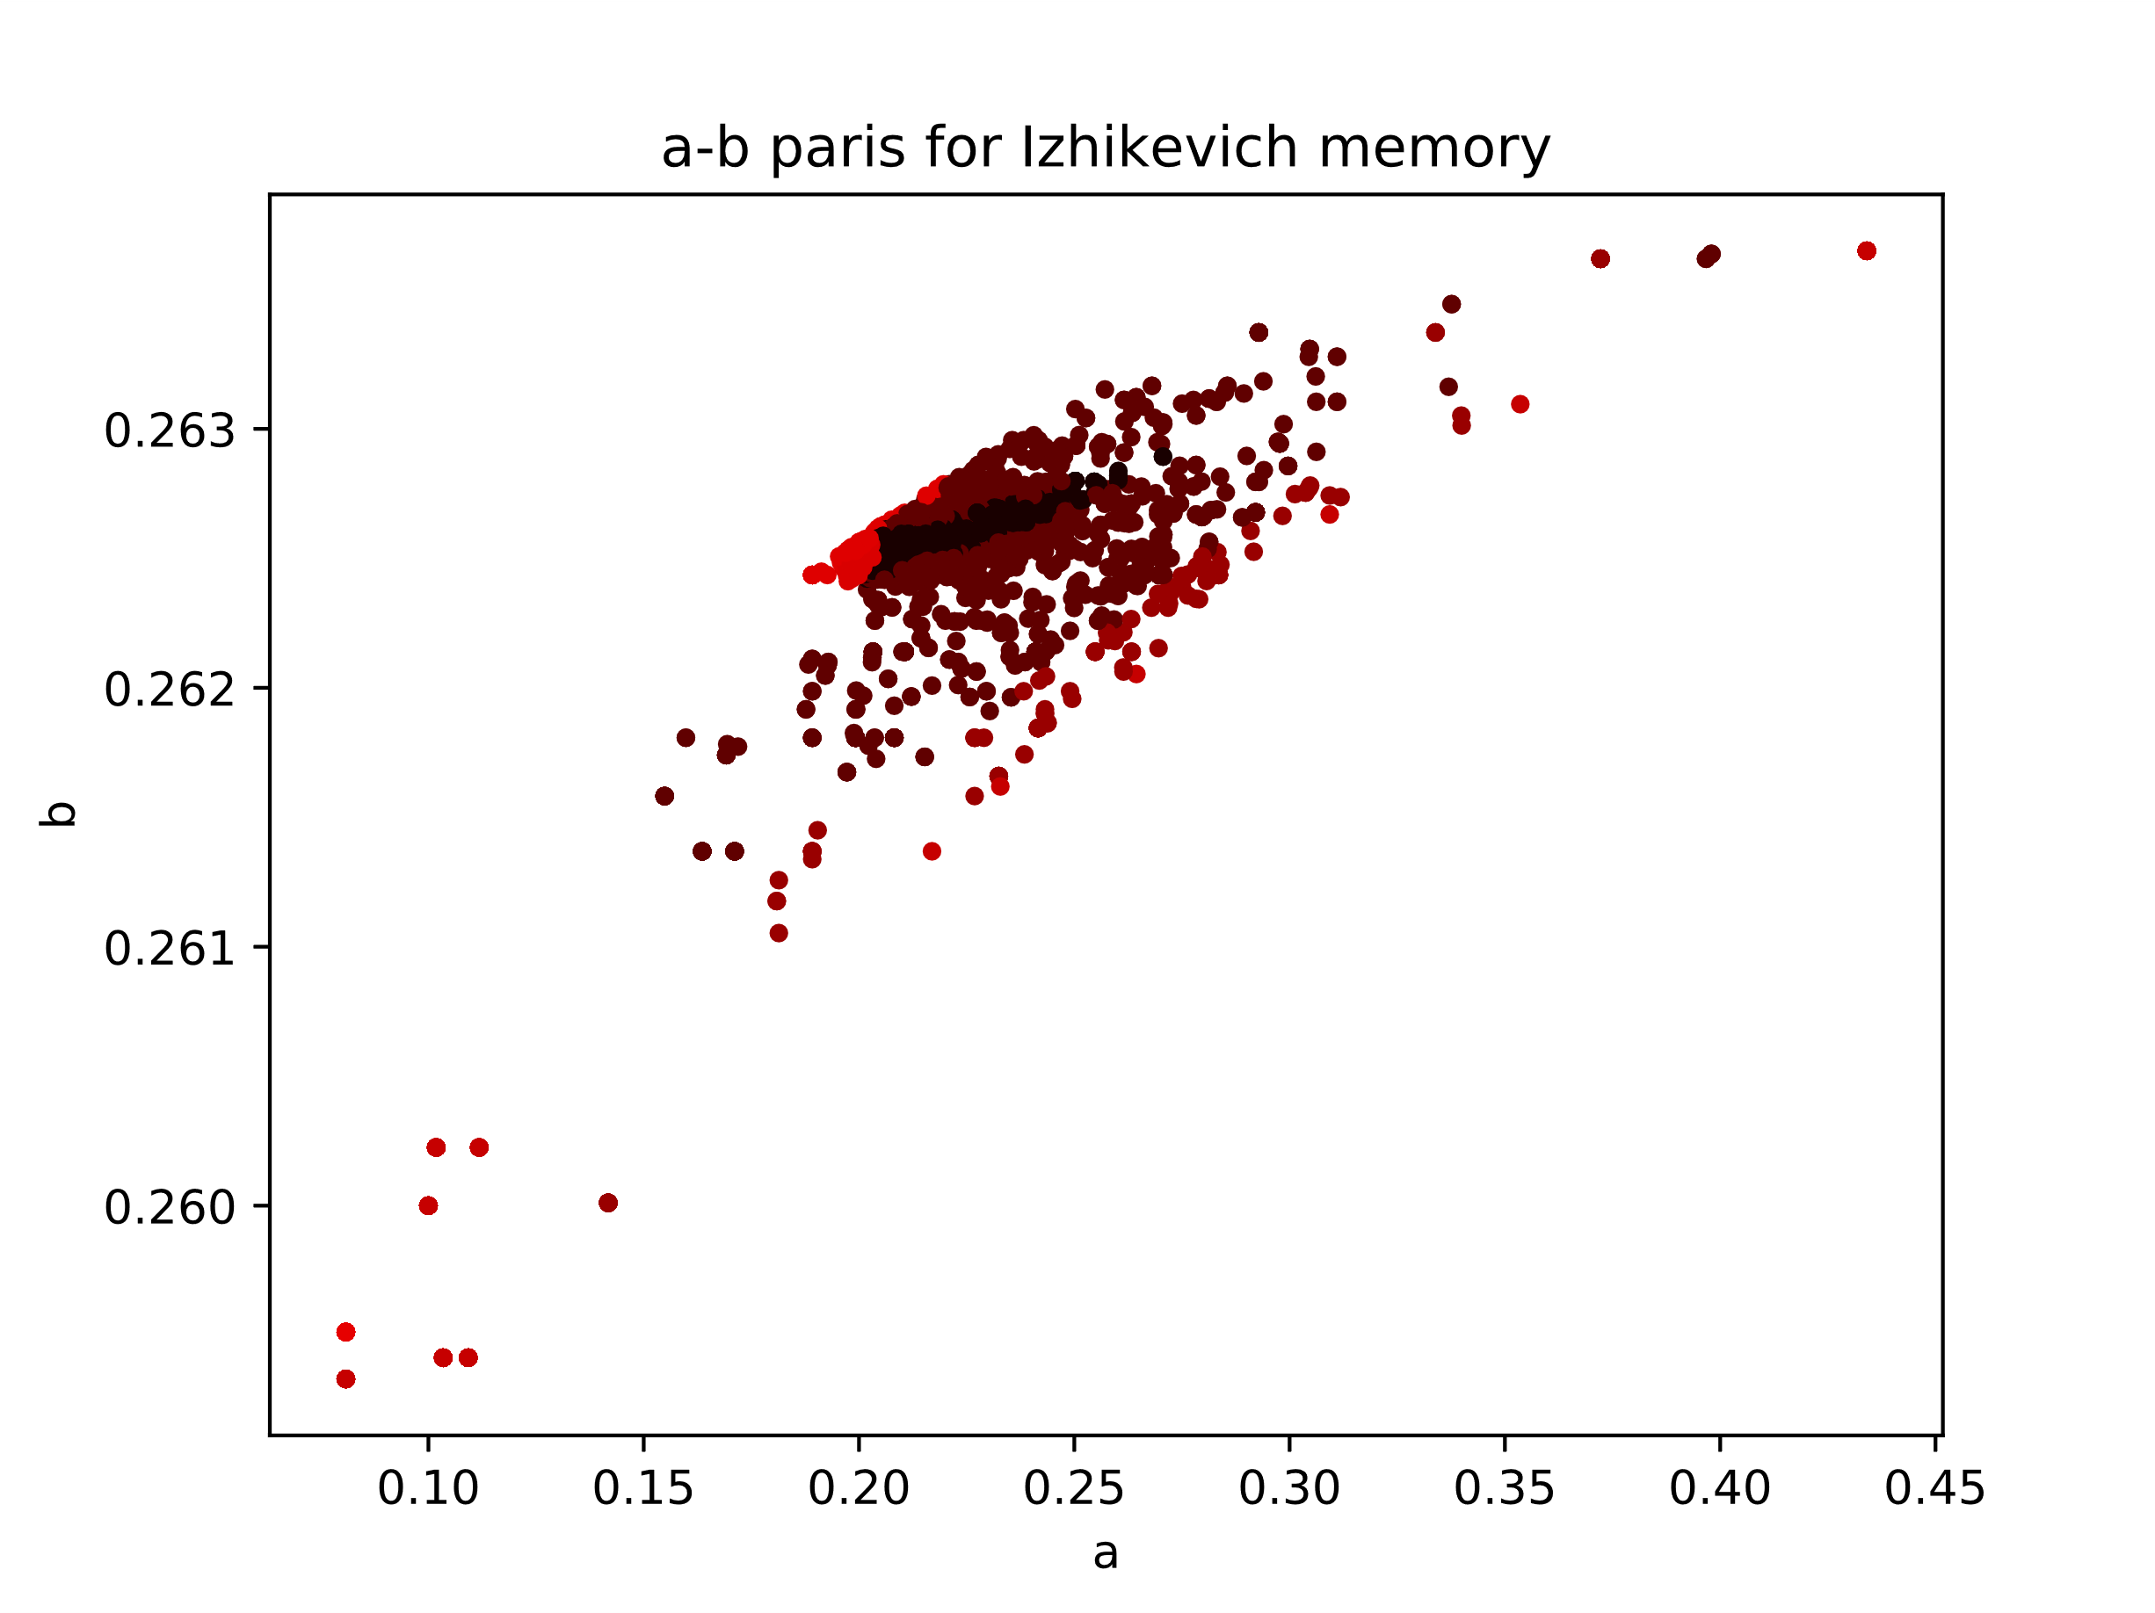
Path 1: genetic algorithm
(a,b) pairs of evolution algorithm result
After a > ~.25
Not much change in b
Value of b converges around .264

Slide 9
Path 2: Bifurcation analysis
As Nakahara and Doya (1998) argue, working memory possible near bifurcation point
Firing pattern change accordingly to fxpt type
May transit from firing to quiescent
LC occur when fxpt unstable
Quiescent when fxpt stable
Bi-stability of Izhikevich model may be related to Hopf bif
I = 0.35
I = 0.15
Hopf-bifurcation
The bi-stability happens here
Notes:
For hopf-bifur, de we need to find a limit cycle to catch that?

Slide 10
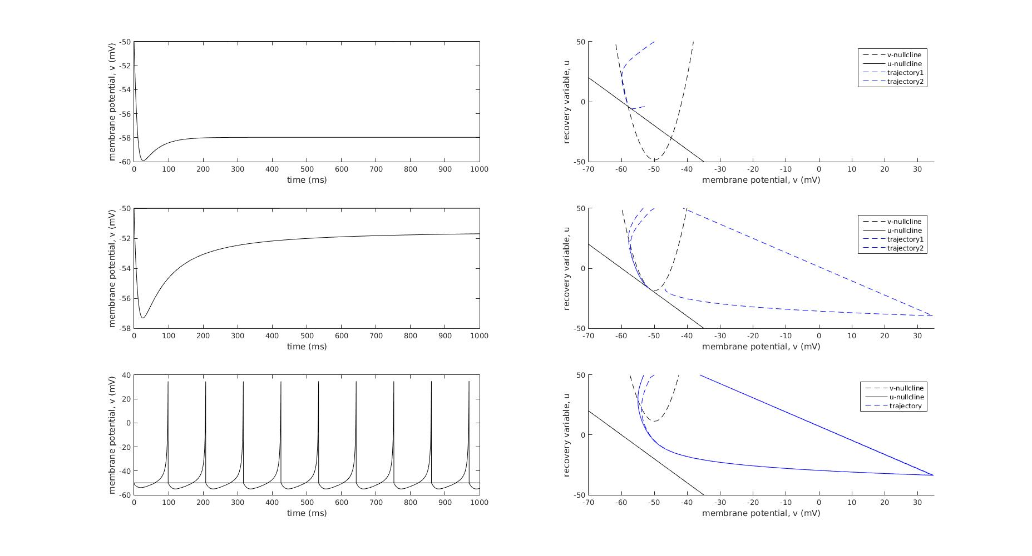
Path 2: Bifurcation analysis
Firing pattern observed when
Fxpt is stable
Saddle node bifurcation
No fxpt
Notes:
For hopf-bifur, de we need to find a limit cycle to catch that?

Slide 11
Path 2: Bifurcation analysis
Find more parameters that enables Hopf-bifurcation
current I
If goes across tau=0
I = 0.0
There are missing parts
→ Other bifurcation exists
If delta > 0
I = 0.4
Genetic algorithm findings with I switching between 0.2 and 0.35
(a, b) curve
Notes:
Delta > 0 otherwise there is no stability change

Slide 12
Phase portrait of another (a, b) point
(a, b) = (0.2958, 0.263)
saddle point
nothing
saddle point
saddle point
saddle point
stable spirals
stable spirals
stable spirals
stable spirals

Slide 13
Phase portrait of another (a, b) point
For fixed (a, b) = (0.2958, 0.263), sweep the stimulus current
Looks like that a saddle-node bifurcation is causing the bi-stability.
Wrong! The saddle point was already there before the stimulation; it is the annihilation of the fixed points that produce the bi-stability
Notes:
Somehow couldn’t reach the small region near Delta=0, can’t visualize what’s happening inside.

Slide 14
Bifurcation diagram of Izhikevich model
(a, b) corresponding to Evolutionary algorithm
Bifurcation between unstable node vs. stable node (Hopf bifurcation)
Value of ‘b’ converges again
This is due to characteristics of hybrid model
Reduced dimensionality (2D) impossible to have LC
Introduce Afterhyperpolarization reset (AHP rest)
Artificial LC
When a > ~.25, no stable fixed point
AHP induce LC for any b

Slide 15
Bifurcation diagram of Izhikevich model
In Izhikevich model, LC occur in nowhere
No fxpt near LC
As aforementioned due to hybrid model
AHP rest

Slide 16
Path 2: Bifurcation analysis
Patch parameters that enables saddle-node bifurcation
current I
Due to annihilation of two stable fixed points
Due to Hopf-bifurcation
I = 0.0
I = 0.4
Genetic algorithm findings with I switching between 0.2 and 0.35
(a, b) curve
Notes:
Delta > 0 otherwise there is no stability change

